Slide 1


SUPERCHARGE YOUR SITE USING AZURE SEARCH
@daveabrock
bit.ly/azure-search-talk

Slide 2


Slide 3


Slide 4
What is Azure Search?
Azure Search is a search-as-a-service cloud solution that provides you APIs and tools for providing a rich experience over content in web, mobile, and enterprise applications
According to Microsoft, its greatest strengths include:
Azure data integration
Portal for central management
Azure scale, reliability, and availability
Core features common to search-centric apps
https://docs.microsoft.com/en-us/azure/search/search-what-is-azure-search
@daveabrock
bit.ly/azure-search-talk

Slide 5
Why use Azure Search?
Use Azure Search to take the complexity out of your hands:
Scalable! Advanced auto-scaling capabilities, much like you are used to for most of the cloud
Advanced querying features! Provides search recommendations, geospatial support and geofencing, scoring profiles, and advanced learning techniques that handles word variations, compound words, and understanding dates and times
Advanced search result handling! Can use faceted navigation, paging, hit highlighting, and more
@daveabrock
bit.ly/azure-search-talk

Slide 6
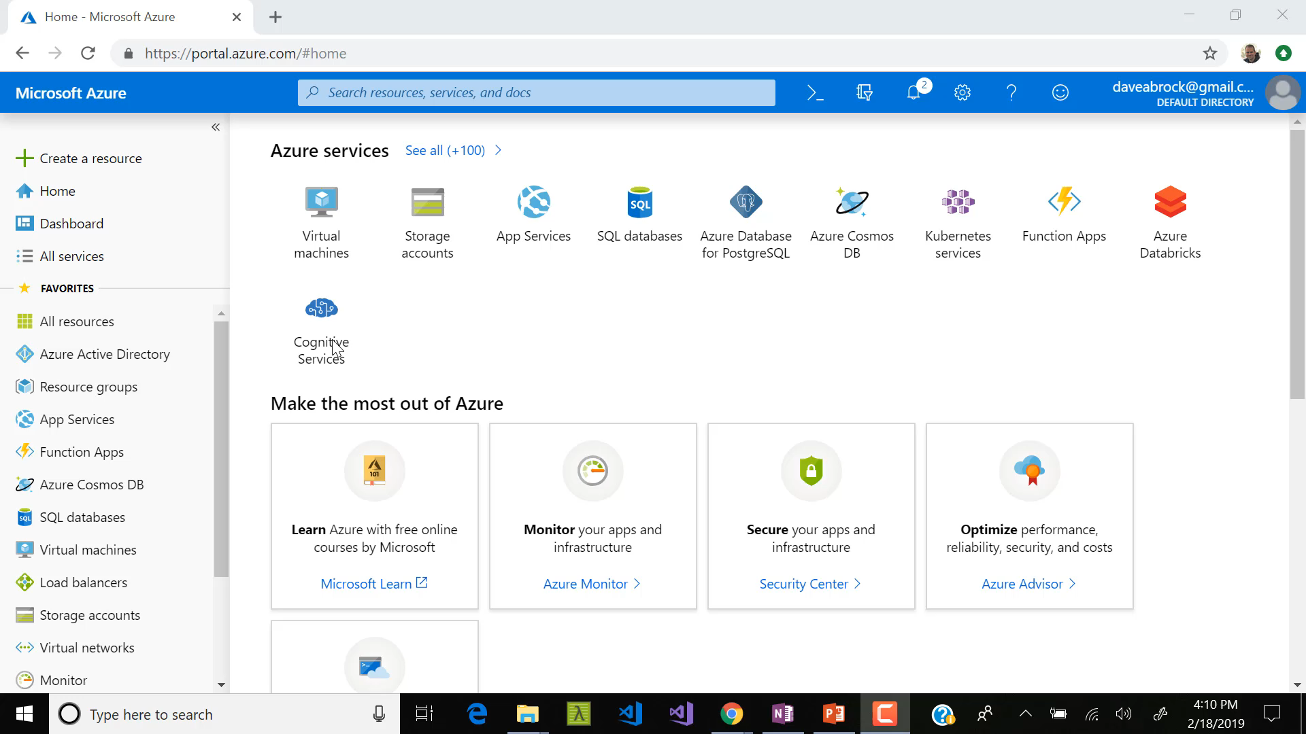

Slide 7
At the core: indexes and documents
When working with Azure search, you will be working with two key components: indexes and documents
Indexes (Guitars)
View indexes as entities, or a table in a typical relational database
Inside Azure search, indexes are optimized for quick lookups
Your queries are broken down into terms that are compared against and index record, which is called a…
Document (Individual Guitars)
Think of a document as a row in a typical database
A document is a JSON-represented, flattened version of data
@daveabrock
bit.ly/azure-search-talk

Slide 8
The big font size should tell you this is important
Documents are not relational.
@daveabrock
bit.ly/azure-search-talk

Slide 9
Create an index
We will create an index and sample documents over REST tonight, but there are many ways to import indexes (and documents):
A few favorites:
An existing data source
Azure SQL database
CosmosDB
Azure Blob Storage
Azure Table Storage
Then you can configure the indexer to “crawl” the data once, hourly, daily, or at a custom interval
@daveabrock
bit.ly/azure-search-talk

Slide 10
Understand search field attributes
When creating an index, understand the following attributes for your fields:
Retrievable - You can return the field in a search result
Searchable – The field is full-text searchable (initiates word-breaking while indexing)
Filterable – The field can be referenced in $filter queries. All fields are filterable by default
Sortable – Allows you to sort by fields other than the score (does not apply to Collection(Edm.String))
Facet-able – Allows you to present search results in specific “categories.” Enabled by default
@daveabrock
bit.ly/azure-search-talk

Slide 11
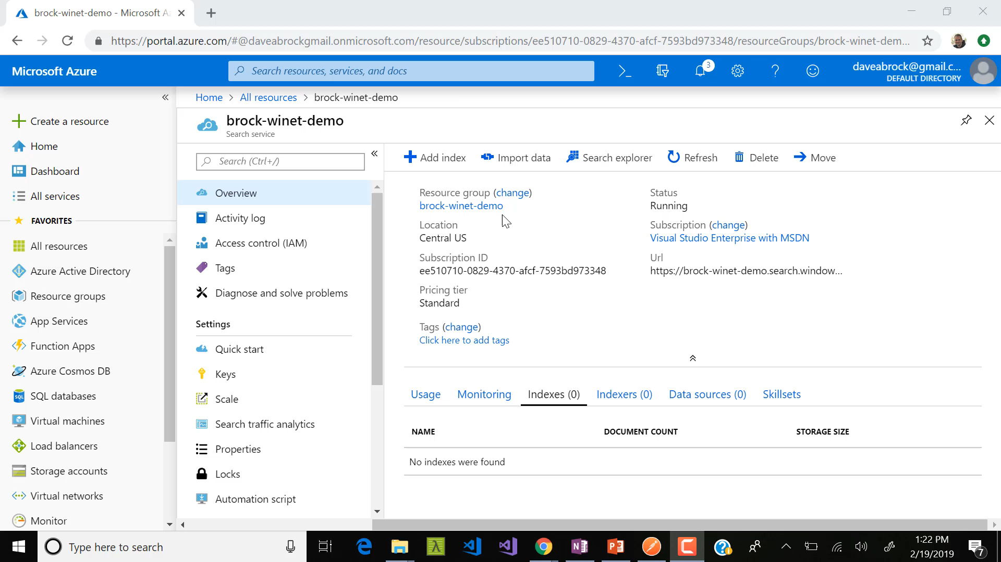

Slide 12
Before you connect to the API…
To connect to the API, you need:
Your path to your Azure search instance
An API key
Primary and secondary admin keys grant full rights to all operations. CAREFUL!
Query keys grant read-only access to indexes and documents
An API version that is required as a query string. The last API update as of this talk is 2017-11-11.
Once you add the API key in the request header, asking the API for your index schema looks like this:
https://<myinstance>.search.windows.net/indexes?api-version=2017-11-11
@daveabrock
bit.ly/azure-search-talk
Notes:
You can only use 50 query keys per search service

Slide 13
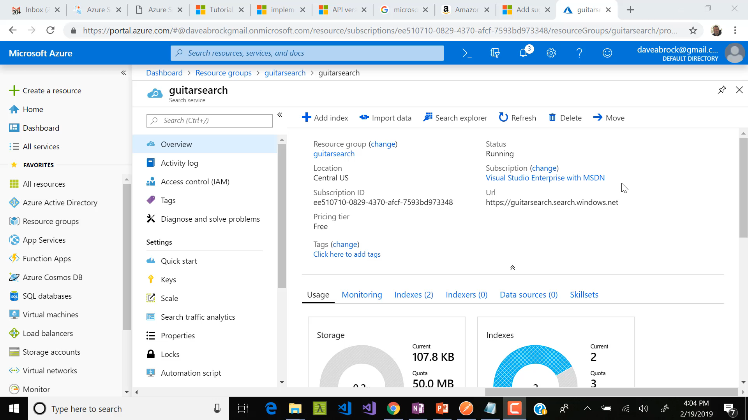
Notes:
You can only use 50 query keys per search service

Slide 14
Choosing an analyzer
By default, Microsoft has you using the Standard Lucene analyzer. It removes possessives from words, applies stemming, and removes unnecessary words.
Consider using Microsoft’s English analyzer. It carries with it a performance hit, but allows added functionality:
Inflections
Fuzzy matching (misspellings)
@daveabrock
bit.ly/azure-search-talk

Slide 15


Slide 16
Populate index with data
Using REST, we can populate using this JSON format:
{
"value": [
{
"@search.action": "upload",
"id": “50",
"brand": "Martin",
"model": "D-28",
"cost": "2768.20",
"type": "Acoustic",
"category": "Dreadnought",
"year": 1970,
"madein": "United States",
"description": "There is no description on this and it's late, so this guitar is awesome, bye.",
"storeid": "2",
"storename": "Chicago Music Exchange"
}
}
@daveabrock
bit.ly/azure-search-talk
Notes:
You can do up to 1000 documents at once.

Slide 17
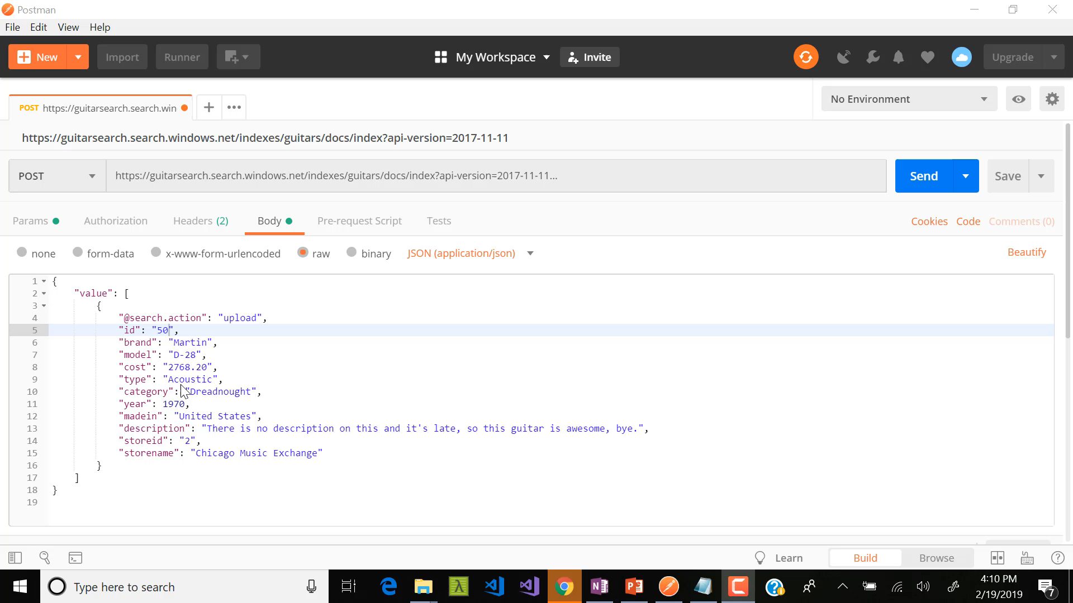

Slide 18
Upload, delete, merge, or upload?
Keep in mind the different ways to perform CUD operations on your documents:
Upload: Much like an upsert, the document is inserted if new and updated or replaced if it exists.
Merge: Updates an existing document with the specified fields. If the document doesn’t exist, the merge fails!
MergeOrUpload: If a key exists, it behaves like a merge. If not, it behaves like an upload. This is much less performant than a merge
Delete: Removes the document from the index
@daveabrock
bit.ly/azure-search-talk
Notes:
You can do up to 1000 documents at once.

Slide 19
Performing queries (you know, searching)
To find my coveted guitar, all I need to know is the ID:
https://guitarsearch.search.windows.net/indexes/guitars/docs/11?api-version=2017-11-11
If I only want to get certain fields, I can use $ for any fields marked retrievable
https://guitarsearch.search.windows.net/indexes/guitars/docs/11?$select=brand,model,type&api-version=2017-11-11
@daveabrock
bit.ly/azure-search-talk
Notes:
You can do up to 1000 documents at once.

Slide 20
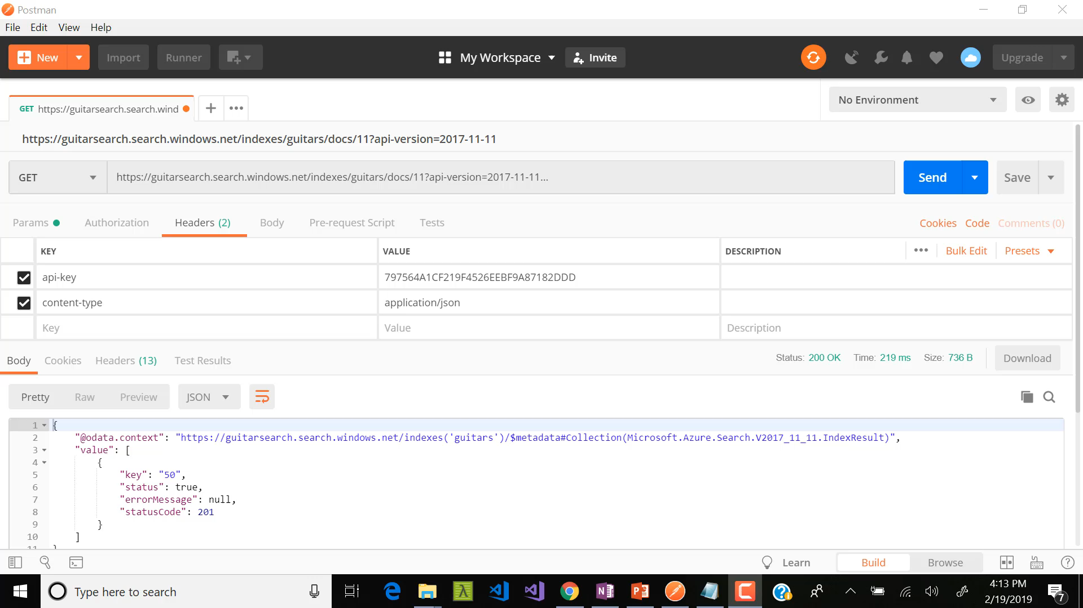

Slide 21
Before we proceed…
How should we call the API?
@daveabrock
bit.ly/azure-search-talk
Notes:
You can do up to 1000 documents at once.

Slide 22

The essential question
Not all that GETs is gold.
William Shakespeare
(paraphrasing)
@daveabrock
bit.ly/azure-search-talk
Notes:
You can do up to 1000 documents at once.

Slide 23
A comparison
Using the GET method, I can easily see what I am doing. I can use familiar query strings.
But I have limited space and I have to encode. I DON’T WANT TO ENCODE.
With a POST, we have much more room to work with, make parameterization easy and don’t have to encode.
From now on, we will be POSTing.
@daveabrock
bit.ly/azure-search-talk
Notes:
You can do up to 1000 documents at once.

Slide 24
Using a POST
Using REST, I can find my guitar using the same filtering by calling:
https://guitarsearch.search.windows.net/indexes/guitars/docs/search?api-version=2017-11-11
And having this in the request body:
{
"search": “d-28",
"select": "brand, model, type”
}
@daveabrock
bit.ly/azure-search-talk
Notes:
You can do up to 1000 documents at once.

Slide 25
Using simple queries
Simple querying is the default mechanism in Azure Search
You can use:
AND (+)
OR (|)
NOT (-)
Suffix (*)
Precedence (())
@daveabrock
bit.ly/azure-search-talk
Notes:
You can do up to 1000 documents at once.

Slide 26
AND
Using a plus sign (+)…
gibson+dreadnought
Gives me documents containing Gibson guitars AND a dreadnought style
@daveabrock
bit.ly/azure-search-talk
Notes:
You can do up to 1000 documents at once.

Slide 27
OR
Using a pipe character (|)…
gibson|dreadnought
Gives me documents containing either Gibson OR a dreadnought OR both of them
@daveabrock
bit.ly/azure-search-talk
Notes:
You can do up to 1000 documents at once.

Slide 28
NOT
Using a minus sign (-)…
fender -Japan
Gives me documents containing the Fender term but not from Japan (either in the ‘Made In’ field or the description)
@daveabrock
bit.ly/azure-search-talk
Notes:
You can do up to 1000 documents at once.

Slide 29
Suffix
Using an asterisk (*)…
Gr*
Gives me documents containing a term that starts with Gr, ignoring case:
Brand: Gretsch
Brand: Greco
Description: ‘Great guitar!’
@daveabrock
bit.ly/azure-search-talk
Notes:
You can do up to 1000 documents at once.

Slide 30
Precedence
Using parentheses ( )…
acoustic+(gibson|martin)
Searches for documents containing the acoustic term and either gibson or martin (or both)
@daveabrock
bit.ly/azure-search-talk
Notes:
You can do up to 1000 documents at once.

Slide 31
Search more granular-ly
Of course, you can also search by field name. If I wanted a guitar that has the term “nice” in the description:
{
"search": "description:nice",
"select": "brand, model, type, description“
}
@daveabrock
bit.ly/azure-search-talk
Notes:
You can do up to 1000 documents at once.

Slide 32
On to full syntax
To boost your Azure search experience even better, take advantage of using full Lucene search
While offering a minor performance hit, you can take advantage of (listing just a subset):
Fuzzy search
Proximity search
Term boosting
Regular expressions
@daveabrock
bit.ly/azure-search-talk
Notes:
You can do up to 1000 documents at once.

Slide 33
Detecting spelling errors
Spelling things wrong will happen, whether your users are busy, on mobile, or drinking (or all three)
Using ~, you will find Martin guitars even when this happens:
{ "search": "martiin~",
"queryType": "full",
"select": "brand, model, type, description“
}
@daveabrock
bit.ly/azure-search-talk
Notes:
You can do up to 1000 documents at once.

Slide 34
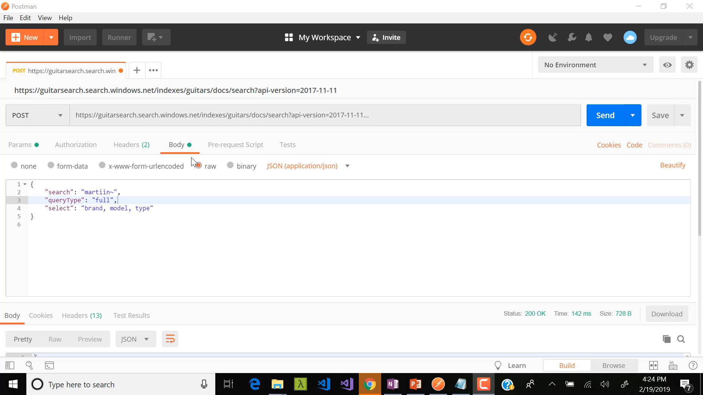

Slide 35
Term boosting
Business rules may dictate that you want to weigh some terms more than others. Let’s say there’s a sale on Gibson acoustics.
Using ^, you can add a boost factor:
{
"search": “gibson^2+acoustic",
"queryType": "full",
"select": "brand, model, type, description“
}
@daveabrock
bit.ly/azure-search-talk
Notes:
You can do up to 1000 documents at once.

Slide 36


Slide 37
Highlighting results data
Using a comma-delimited string, you can get back fields to highlight and use tags to style accordingly.
{
"search": “Electric",
“highlight”: “type”
“highlightPreTag”: “<div style=‘mark-yellow’>”
“highlightPostTag”: “</div>”
"queryType": "full",
"select": "brand, model, type, description“
}
@daveabrock
bit.ly/azure-search-talk
Notes:
You can do up to 1000 documents at once.

Slide 38
Using facets
Facets are common, and expected, on the web today. Facets are used to filter search results based on “categories”
Anything you mark as “facetable” can do this, so long as they are:
Edm.String
Edm.DateTimeOffset
Edm.Boolean
Edm.Collections
Numeric types
@daveabrock
bit.ly/azure-search-talk
Notes:
You can do up to 1000 documents at once.

Slide 39
A quick facet
To filter by brand, you could send this along in your request:
{
“search”: “*”,
“facets”: “brand”
}
@daveabrock
bit.ly/azure-search-talk
Notes:
You can do up to 1000 documents at once.

Slide 40
Intervaled facets
To filter by brand, you could send this along in your request:
{
“search”: “*”,
“facets”: [
“cost,values:100|500|1000”
]
}
@daveabrock
bit.ly/azure-search-talk
Notes:
You can do up to 1000 documents at once.

Slide 41
Using autocomplete
There is now an Autocomplete API in preview, that has three modes:
oneTerm: only one term is suggested
twoTerms: matches two-term phrases in the index
oneTermWithContext: completes last term in query with two or more terms that exist
@daveabrock
bit.ly/azure-search-talk
Notes:
You can do up to 1000 documents at once.

Slide 42
A sample autocomplete request
{
"autocompleteMode": "oneTerm",
"minimumCoverage": 80,
"search": “gib",
"searchFields": “brand",
"suggesterName": “guitars",
}
@daveabrock
bit.ly/azure-search-talk
Notes:
You can do up to 1000 documents at once.

Slide 43
Scoring profiles
By default, Azure provides a search score for a returned item—an indicator of an item’s relevance. The higher the score, the more relevant it is
Items are ranked from highest to lowest
You can customize (and override) using a scoring profile to give yourself more control
This is often uses with geo data
@daveabrock
bit.ly/azure-search-talk
Notes:
You can do up to 1000 documents at once.

Slide 44
Scoring profiles
By default, Azure provides a search score for a returned item—an indicator of an item’s relevance. The higher the score, the more relevant it is
Items are ranked from highest to lowest
You can customize (and override) using a scoring profile to give yourself more control
This is often uses with geo data
@daveabrock
bit.ly/azure-search-talk
Notes:
You can do up to 1000 documents at once.

Slide 45
Scoring profiles
Let’s say we want to look at guitars that are close to us. We would add something like this:
“scoringProfiles”: [
“name”: “closestGuitars”,
“functions”: [
“type”: “distance”,
“fieldname”: “storeLocation”,
“boost”: 10,
“distance”: {
“referencePointParameter”: “myHouse”,
“boostingDistance”: 10
}
]
]
@daveabrock
bit.ly/azure-search-talk
Notes:
You can do up to 1000 documents at once.

Slide 46
A C# example
<demo />
@daveabrock
bit.ly/azure-search-talk
Notes:
You can do up to 1000 documents at once.

Slide 47
What we missed
Other great features of Azure Search:
Geolocation and geofencing
Cognitive Search
Synonyms
Administration (managing API key access, adjust service capacity, monitor resource utilization)
@daveabrock
bit.ly/azure-search-talk
Notes:
You can do up to 1000 documents at once.

Slide 48


Thank you!
Resources
Azure Search docs
.NET Azure Search examples on GitHub
Node.js Example
Recommended Pluralsight course
(slides)
@daveabrock
bit.ly/azure-search-talk

